Slide 1

Hotel Booking
Group members:
Russ Sobi
Charles Baker
Sukhman Kaur
Min Hset Hlaing

Slide 2
Table of Contents
Objective
Tables Used
Table Relationships Diagram
Basic UI Diagram
SQL (queries, triggers, etc)
QR Code!!!
Challenges Faced
Questions

Slide 3
Objectives
The main objective of this project is to create a database management system for a hotel.
Another objective was to be able to understand and write code that connects the database and sql aspect of the class that we learned all quarter to a real app for application.

Slide 4
Tables Used
Guest
ID
First and Last names
Email
Ph. Number
Address (city, state, zip)
Room
Room Number
Room Type (Suite, Regular, Basic)
Room Price
Room Key
ID
Room Number
Expiration
Booking
ID
CustomerID
Room Number
Check-in Date
Check-out Date
Checked-in
Receipt
ID
GuestID
BookingID
ReceiptDate
TotalAmount

Slide 5
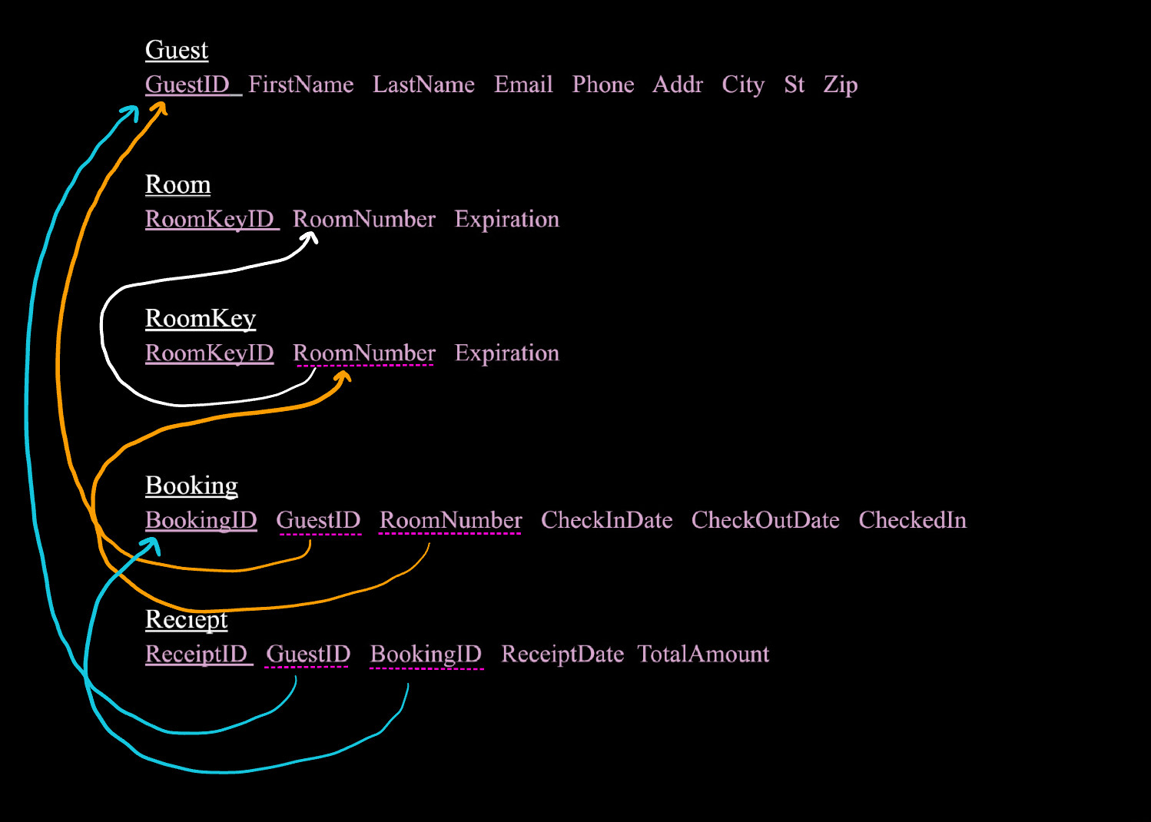
Relationships Between Tables

Slide 6

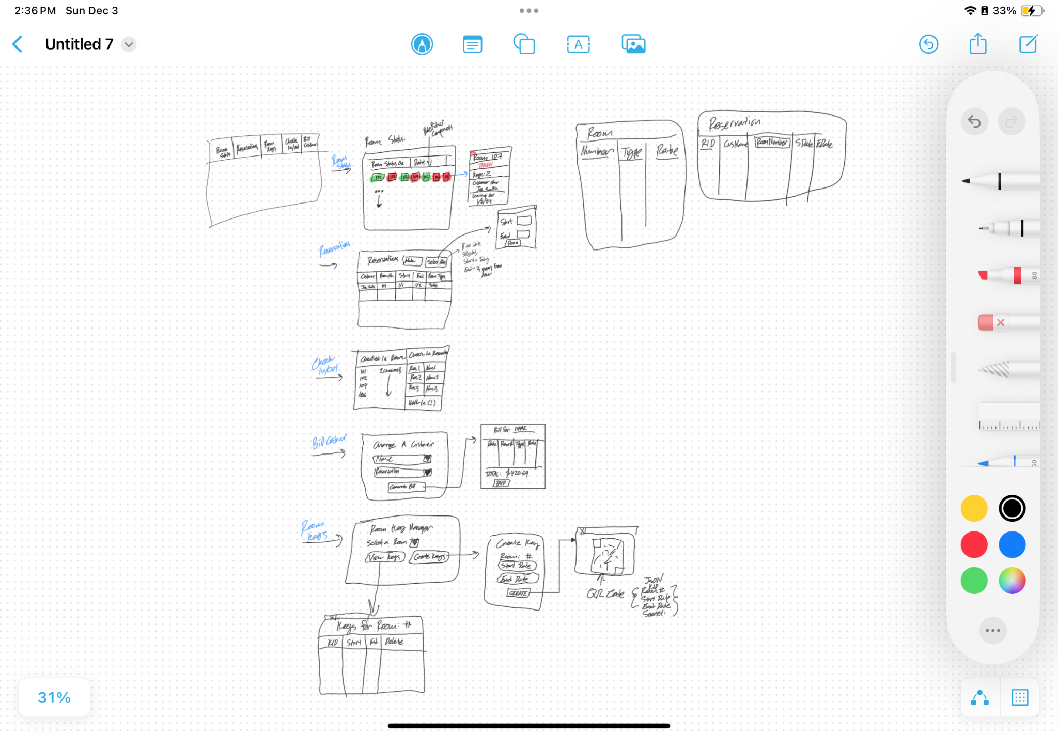
UI Flow Diagram

Slide 7
UI Flow Diagram

Slide 8
UI Flow Diagram

Slide 9
UI Flow Diagram

Slide 10

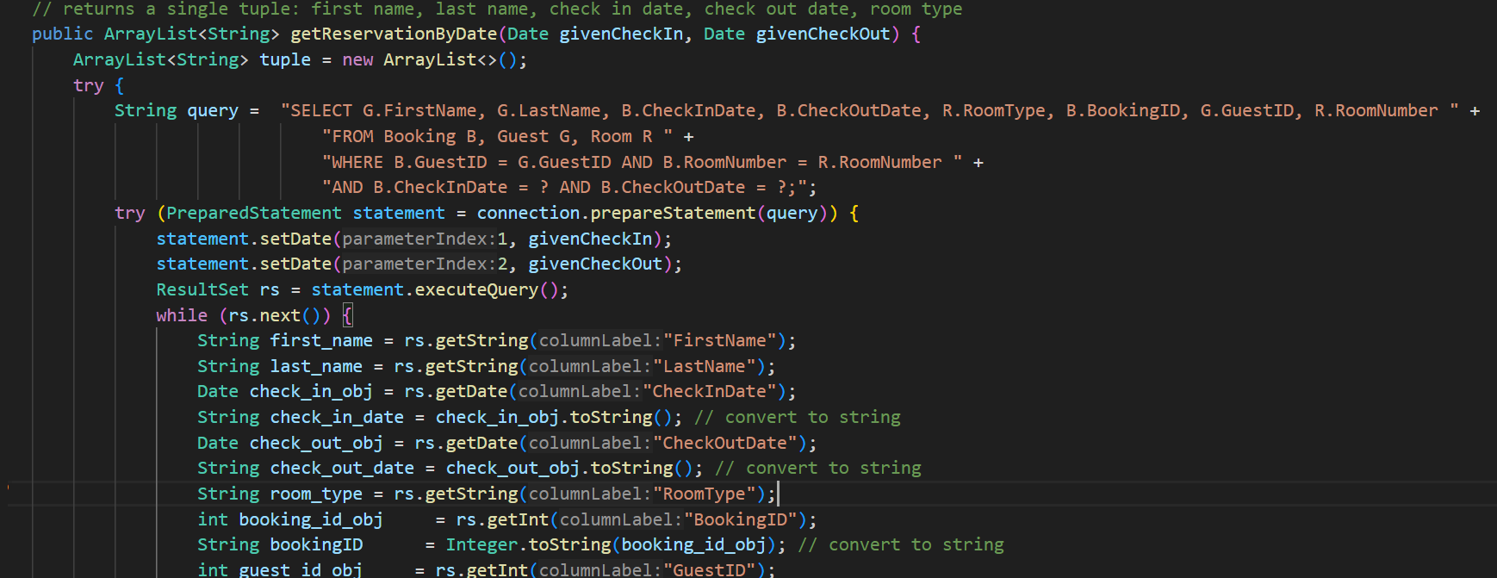
SQL queries, views, etc...

Slide 11
Challenges Faced
Initial planning of the app
Wireframe helped immensely
Needing to interact with the database at different layers of the app
Passed along the connection rather than creating a new one every time to avoid zombies.
Generating the QR code for the room keys
Leveraging Google’s API for text QR codes required using Maven to set up dependencies
Making the UI responsive to data changes
Needed to use a Swing timer for data refresh, constantly calling for redraw.
AWT had a major learning curve as we were all not used to GUI programming

Slide 12
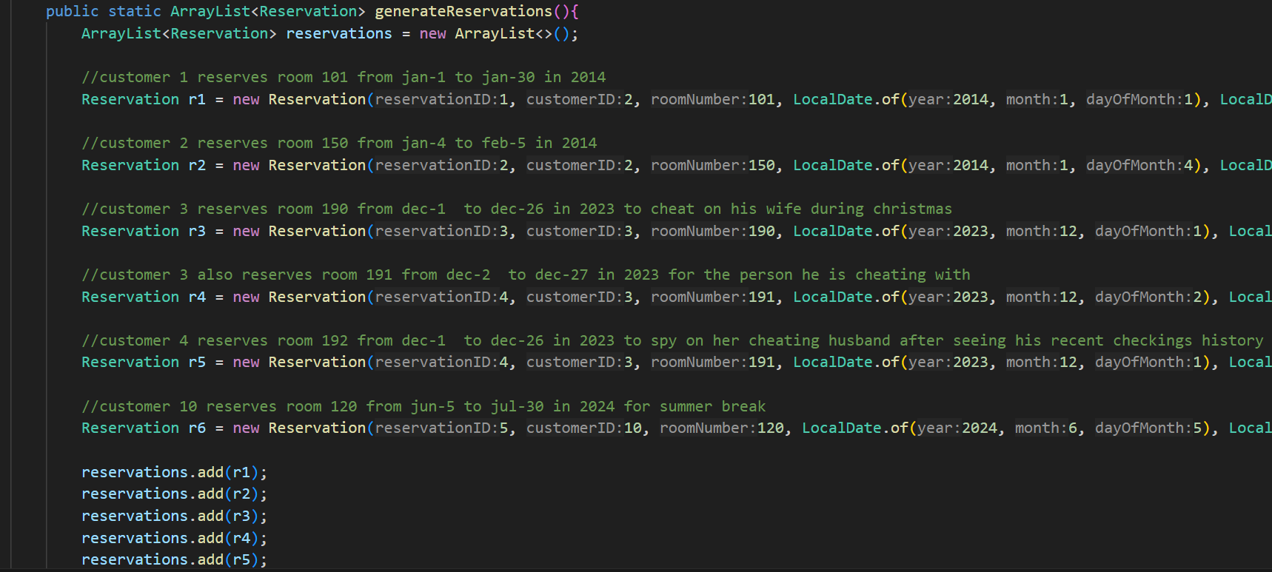
Having some fun with the data

Slide 13
Questions
Or comments
Or clarifications

Slide 14
Thank you

